Slide 1
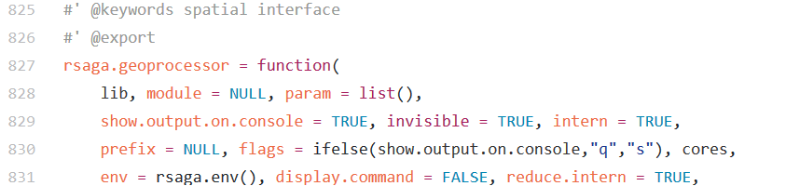

Integrating R with GIS for innovative geocomputing – the examples of RQGIS and RSAGA
Jannes Muenchow, Patrick Schratz, Donovan Bangs, Alexander Brenning
Notes:
Hello everybody, thank you for coming. Today I would like you to introduce to the RQGIS package. It integrates R with QGIS for advanced geocomputing since it combines the best of two worlds. ON the one hand it uses the geoprocessing power of QGIS and on the other hand it uses the statistical and analytical power of R.
Unbedingt Patrick Schratz danken

Slide 2
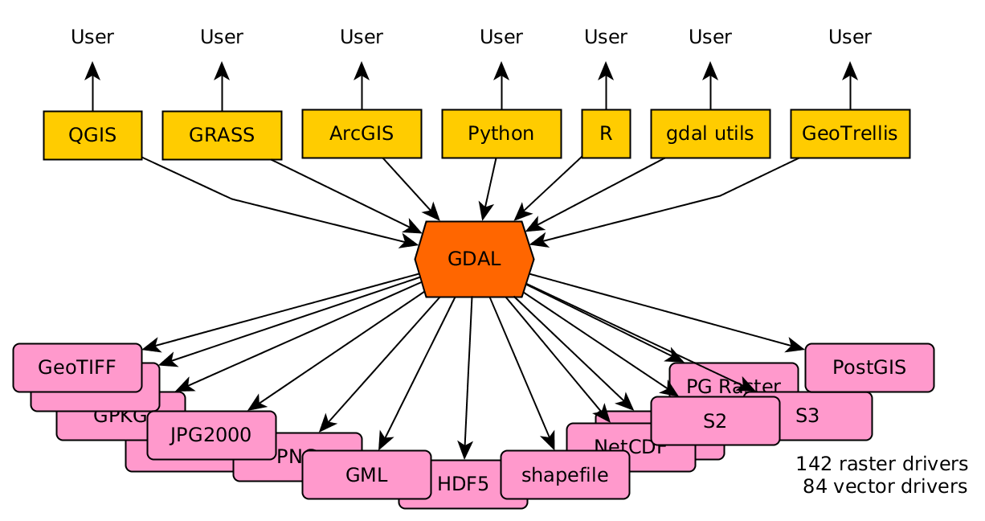
R as a GIS
More than 100 geo-related R packages (https://cran.r-project.org/web/views/Spatial.html)
http://r-spatial.org//2016/11/29/openeo.html

Slide 3
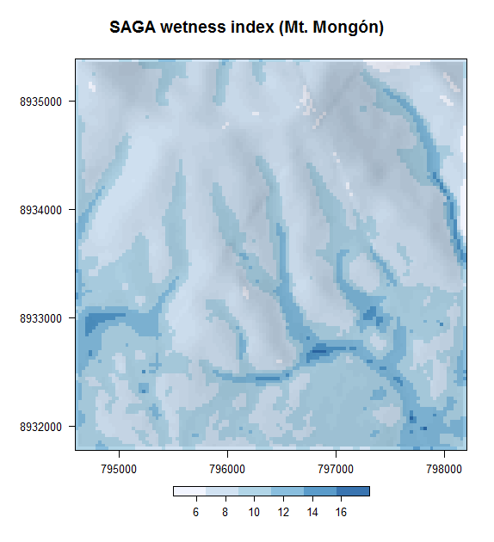
But:
R was never designed as a GIS
Computationally demanding operations
Missing geoalgorithms
Notes:
Catchment area
Catchment slope
Saga Wetness Index
Lidar processing
…

Slide 4

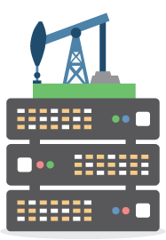
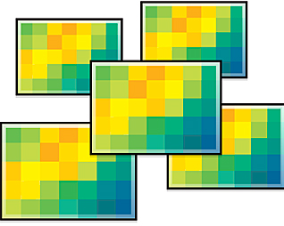
Combining the best of two worlds
http://www.esri.com/
https://7segments.com/
Notes:
QGIS (variable retrieval):
Plan and vertical curvature, SAGA wetness index, catchment slope, catchment area, NDVI
R (statistical analysis):
Variable selection, Non-linear Poisson model and spatial prediction

Slide 5


Navigation
1. R as a GIS
2. R-GIS integration
RSAGA
3. R-GIS examples
RQGIS
4. RQGIS vs. RSAGA
Navigation
Click buttons to jump to content
(5. RQGIS usage)
Notes:
Many disciplines are already using the R-GIS integration, think of, geomorphology, ecology, climatology, archeology but there are also applications in the humanities.

Slide 6

R as a GIS
Jump to Navigation

Slide 7
R as a GIS
More than 100 geo-related R packages (https://cran.r-project.org/web/views/Spatial.html)
Package rgdal for importing and exporting geodata
http://r-spatial.org//2016/11/29/openeo.html

Slide 8
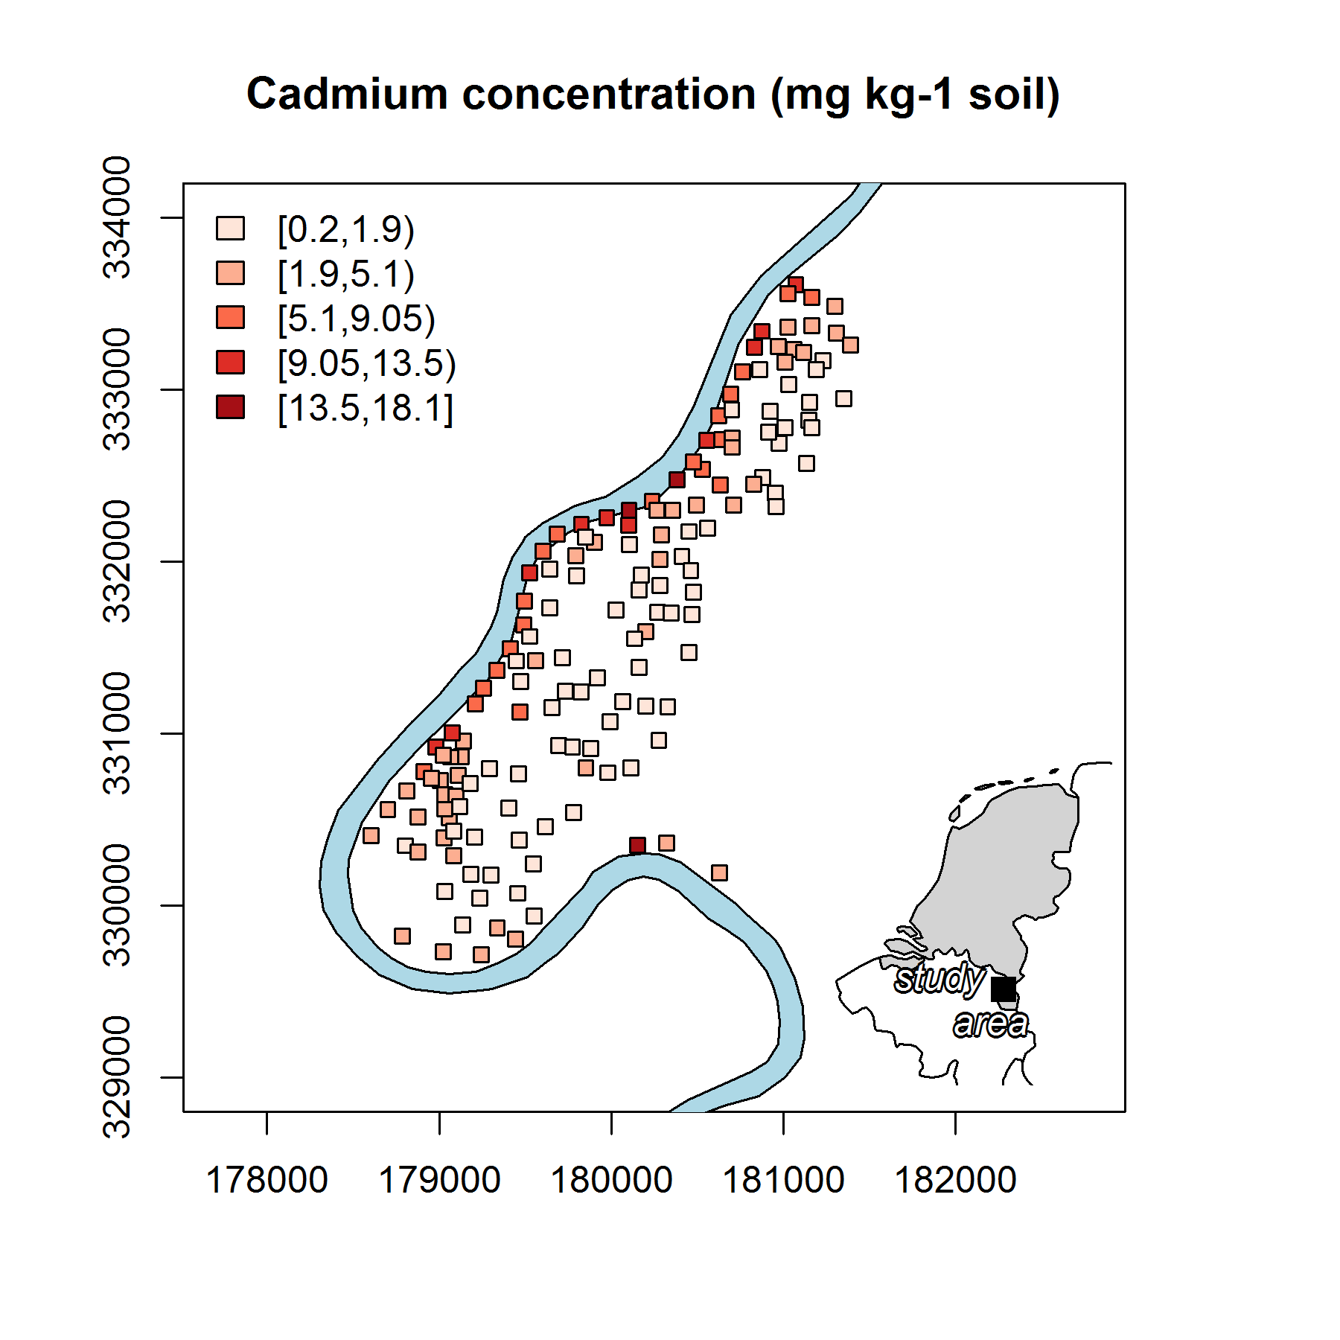
R as a GIS
More than 100 geo-related R packages (https://cran.r-project.org/web/views/Spatial.html)
Package rgdal for importing and exporting geodata
Packages sp and sf for vector geodata
Data: Rikken, M.G.J & Van Rijn, R.P.G. (1993).

Slide 9
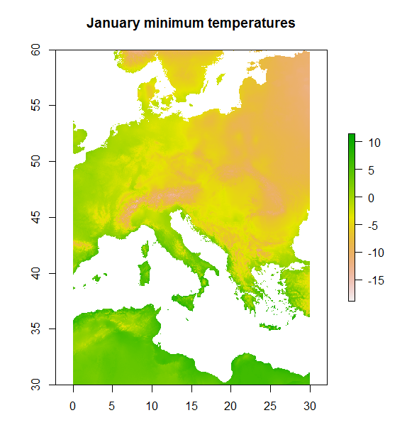
R as a GIS
More than 100 geo-related R packages (https://cran.r-project.org/web/views/Spatial.html)
Package rgdal for importing and exporting geodata
Packages sp and sf for vector geodata
Package raster for raster geodata
Data: http://www.worldclim.org/.

Slide 10
R as a GIS
Defining a GIS as a system for the analysis, manipulation and visualization of geographical data (Longley, Goodchild, Maguire, and Rhind 2011), one could argue that R has become a GIS

Slide 11


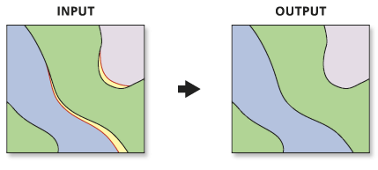
But what about…
(digitizing)
(Geodatabase-functionality
and topology rules)
http://www.unioneag.org
http://help.arcgis.com/

Slide 12
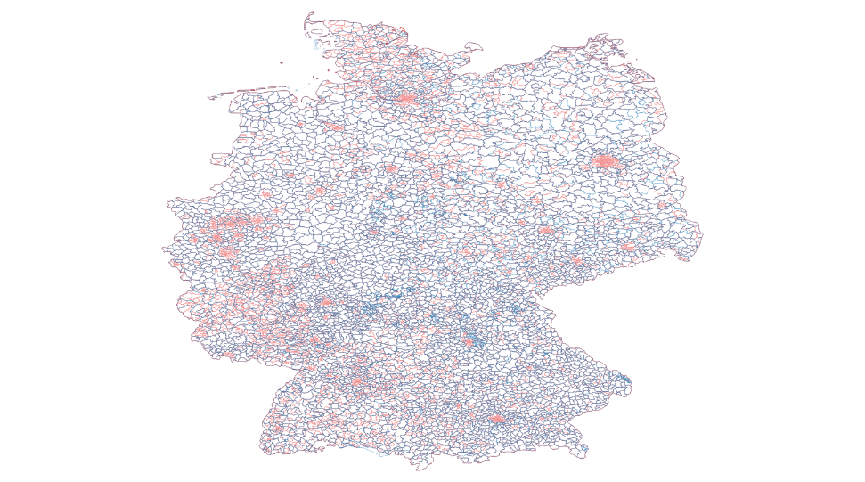
Computationally demanding operations
Computationally demanding operations

Slide 13
Missing geoalgorithms
Catchment area
Catchment slope
Saga Wetness Index
Lidar processing
…

Slide 14
Interface
R has been designed from the beginning as an interactive interface to other software packages (Chambers, 2016).

Slide 15

R-gis Integration - RQGIS and RSAGA
Jump to Navigation

Slide 16
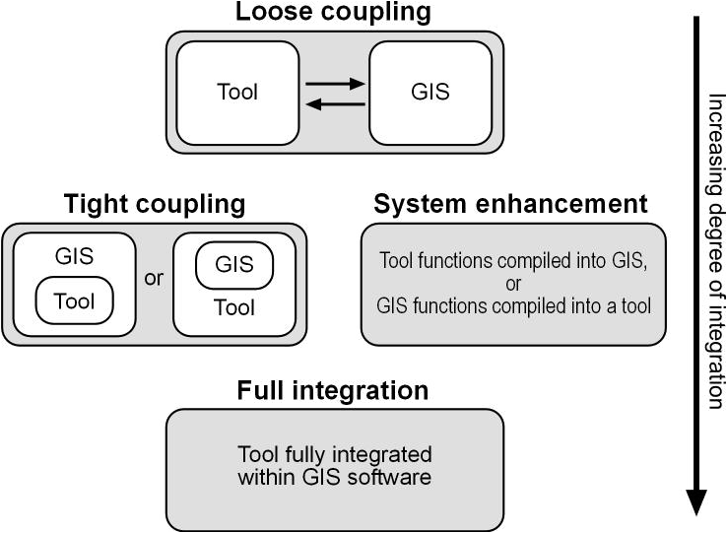
GIS interfaces
http://www.geocomputation.org/2000/GC009/Gc009.htm
Notes:
Loose coupling -> import and export of data
Tight coupling: access GIS functionalities from within R (tool); also possible to access R power from within GIS (e.g., GRASS, ArcGIS)

Slide 17


R-GIS integration
RSAGA
RQGIS
rgrass7
RPyGeo

Slide 18
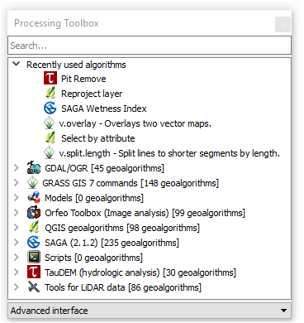
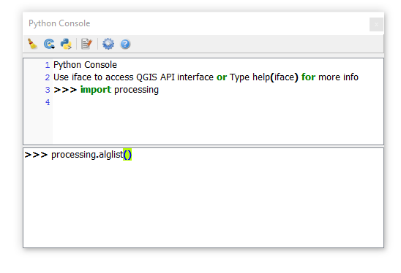
QGIS – Python API
Notes:
I think most of you are familiar with the processing toolbox of QGIS the QGIS processing toolbox from within R. These geoalgorithms can be accessed via the Python API. So I wondered if it was possible to do so also from within R.
Processing package is equivalent to the arcpy package of ArcGIS.

Slide 19




How does it work?
Access QGIS Python API via command line (old interface)
The new interface (still work in progress) uses the reticulate package to establish a QGIS Python-tunnel, please refer to:
https://github.com/jannes-m/RQGIS/tree/rPython
Notes:
Skimming through thousands of lines of Python code

Slide 20
Most notable features of RQGIS
QGIS geoalgorithms
Access to hundreds of further geoalgorithms, especially SAGA- and GRASS-geoalgorithms
R users can stay in their environment without having to touch Python
Convenience functions open_help, get_args_man and run_qgis

Slide 21
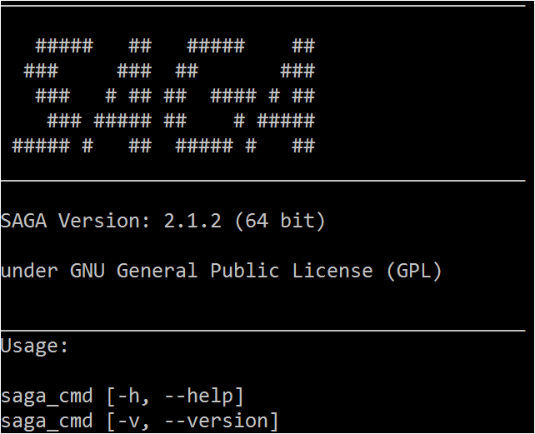
RSAGA interface
The RSAGA package provides R geocomputing functions that make use of the command line interface of SAGA GIS, saga_cmd.exe, to execute SAGA GIS modules.

Slide 22
RSAGA structure
Geoprocessing environment
List data structure with information on working directory, location of
SAGA GIS binaries, etc.
Geoprocessor (using SAGA GIS)
Workhorse that calls SAGA GIS and provides low-level access to all
SAGA GIS modules
User-level interface functions (using SAGA GIS):
e.g., rsaga.local.morphometry, rsaga.hillshade
Local and focal functions (written in R):
e.g., multi.focal.function, grid.predict
Utility functions (written in R):
e.g., pick.from.ascii.grid

Slide 23

R-gis Examples
Jump to Navigation

Slide 24
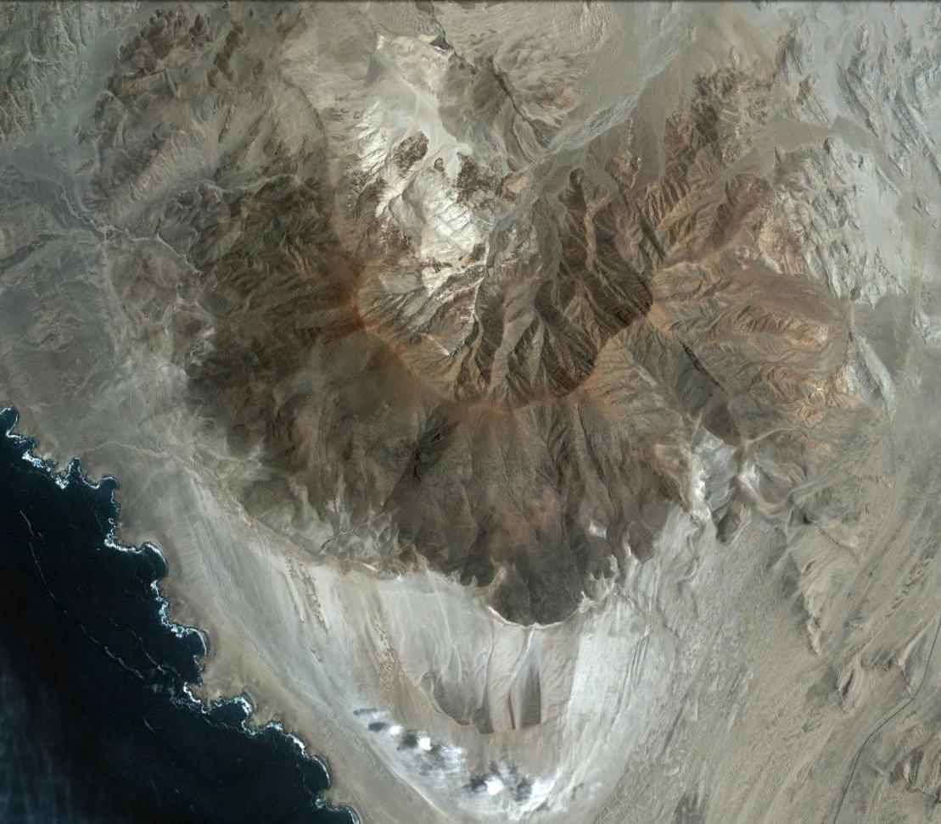
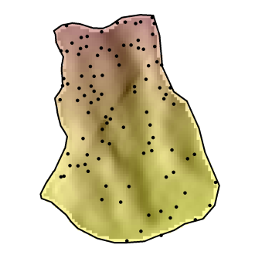
Study area – Mount Mongón
Mongón
Source: Google Earth.
Notes:
The study area is located in the Peruvian coastal desert. The mountain is called Mount Mongón and reaches an altitude of 1100 masl. I randomly sampled 100 locations/plots on the southern slope of this mountain. The plots were 4x4 meters in size and each of these plots I determined every single plant species.

Slide 25
Non-linear Poisson model
Predictors:
Altitude
catchment slope
catchment area
SAGA wetness index
Curvatures
solar radiation
etc.
Notes:
The catchment slope output grid of the Catchment Area (Parallel) module is computed like this: for each cell, the local slope is calculated using the approach of Zevenbergen & Thorne. These slope values are accumulated downslope. Finally, for each cell the accumulated slope values are divided by the derived catchment area of the cell. The unit of the grid are radians.
I guess you can think of it as an average slope value and not the slope value at a specific location

Slide 26
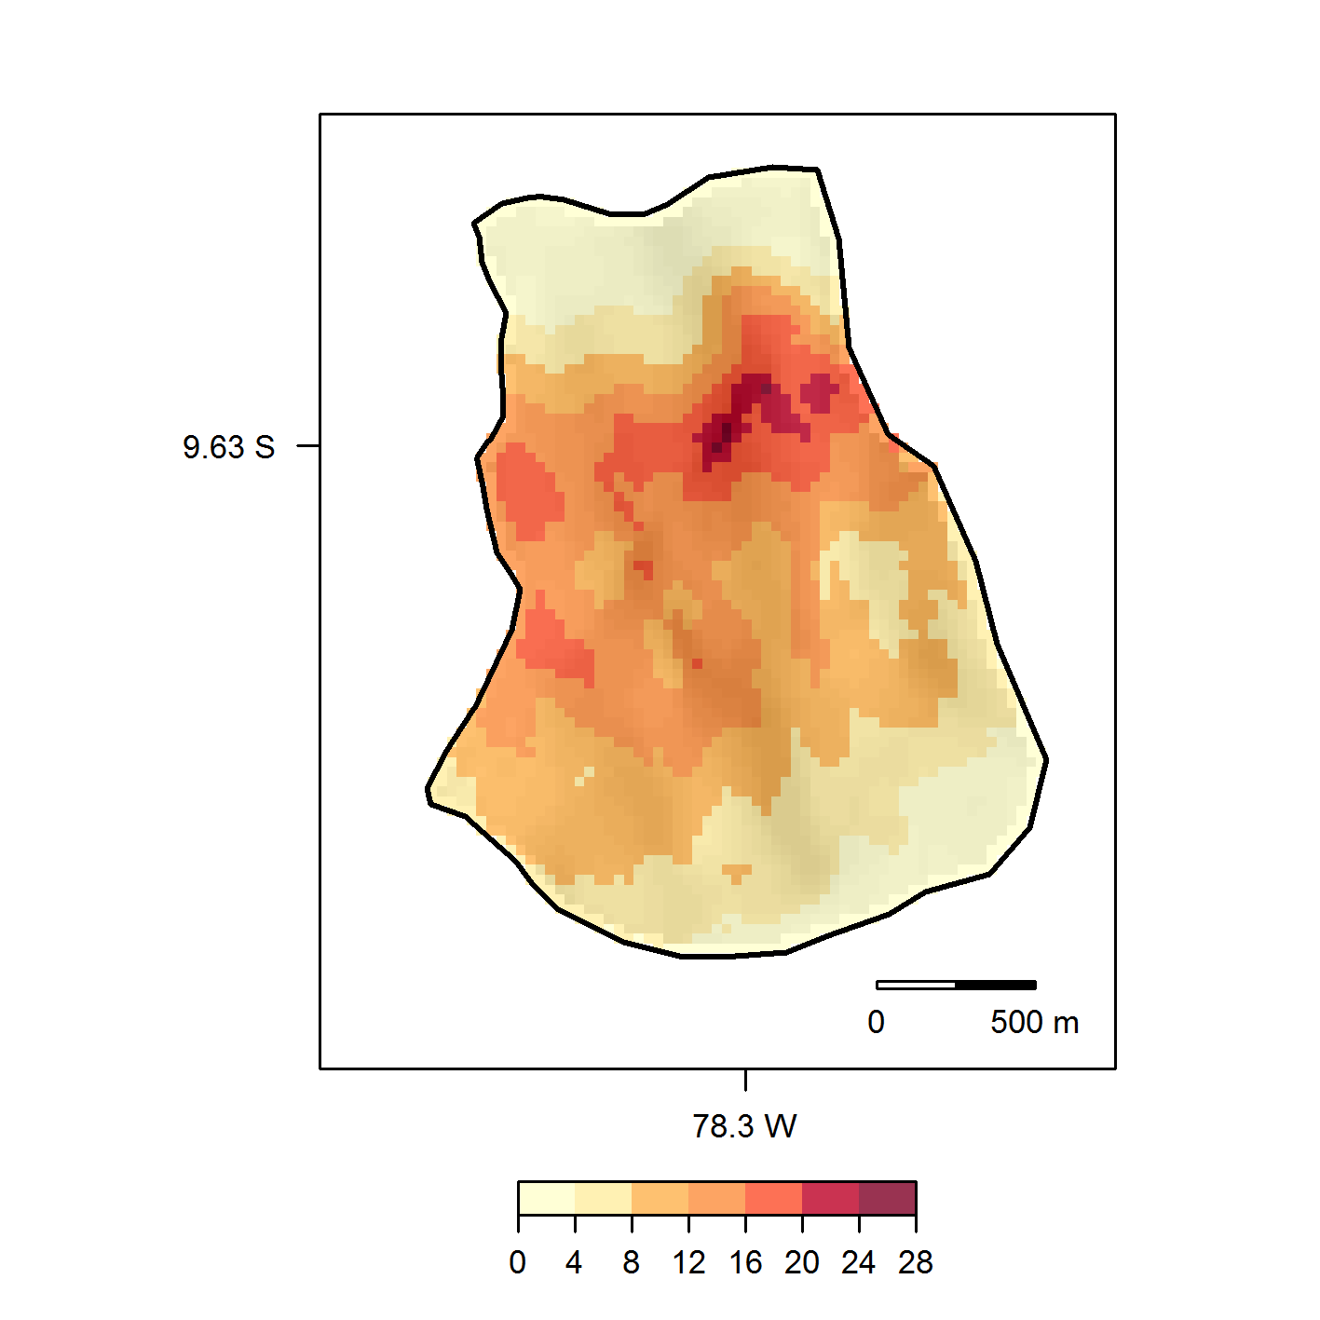
Spatial prediction of alpha diversity
Muenchow et al. (2013): Predictive mapping of species richness and plant species' distributions.
Notes:
GAM, GLM and other distributions, mixed-effect models, Bayesian models, machine learning, spatial cross-validation, incorporating spatial autocorrelation and kriging techniques
But that is just one example of R-GIS integration:
Stream networks
Surface roughness
Various wetness indexes
Terrain- and landform classification
Physically-based models
LiDAR tools
Wind speed, wind direction
Routing algorithms, neighbour calculations (topology)
Computationally demanding vector operations (overlay)

Slide 27
Landslide susceptibility
Brenning et al. (2015): Landslide susceptibility near highways.

Slide 28
Rock glaciers/permafrost
Computation of direct and diffuse incoming solar radiation using RSAGA
Azócar et al. (2017): Permafrost distribution modeling.

Slide 29
Geomarketing
Unioning postal code with municipality layers

Slide 30
Further applications
Soil classes and mapping (e.g., Brungard et al. 2015)
Stream networks (e.g., Hengl et al. 2010)
Climatology (rainfall prediction; e.g., Hengl et al. 2010)
Archeology (e.g., Borck 2016)
Socio-demography(population index prediction; e.g., Bajat et al. 2012)
…

Slide 31


comparing rqgis and rsaga
Jump to Navigation
Notes:
I won‘t talk much about ESRI ArcGIS and instead focus on the comparison between RQGIS and RSAGA and rgrass7

Slide 32
RQGIS vs. RSAGA/rgrass7
Unified interface to SAGA and GRASS
Interface to further 3rd-party providers
Easier-to-use
get_args_man, open_help
On-the-fly import/export of spatial objects (run_qgis)
Automatic data conversions (e.g., asc, tif, etc.)

Slide 33
But:
QGIS does not support the most recent SAGA versions
QGIS does not provide access to all SAGA and GRASS functionalities
RSAGA has special geocomputing functions (written in R)
Notes:
Special SAGA functions multi.local.function, grid.predict, pick.from.ascii.grids

Slide 34

Wrap-up
We can use R as a GIS
Geoprocessing is better done in a GIS
R-GIS integration combines the best of two worlds
RQGIS, RSAGA, rgrass7 are all great
http://www.myazpiration.com/wp-content/uploads/
2014/11/Partnership-5.png
http://www.esri.com/
https://7segments.com/
Data: Rikken, M.G.J & Van Rijn, R.P.G. (1993).
Notes:
Main advantages of RQGIS:
Most popular desktop GIS
Lets the user also access third-party providers (SAGA, GRASS, OTB, Taudem, …)
Easier to use for non-GISexperts (data conversions, get_args_man)
QGIS geoalgorithms

Slide 35
Rqgis usage
Jump to Navigation

Slide 36
RQGIS on github
Find out how to use RQGIS on github:
http://jannes-m.github.io/RQGIS/index.html

Slide 37
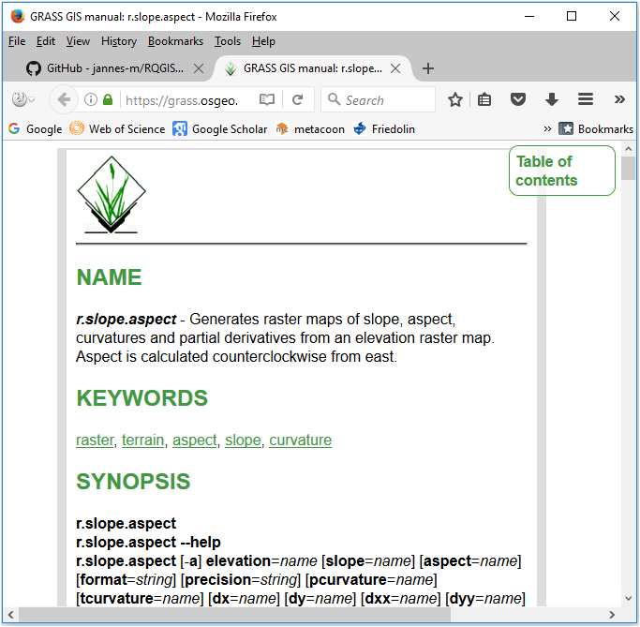
Access to the online help
Let‘s run:
library("RQGIS")
qgis_env <- set_env("C:/OSGeo4W64/")
open_help(alg = "grass7:r.slope.aspect",
qgis_env = qgis_env)

Slide 38
Automatic argument retrieval
The QGIS Python API does not provide a way to collect function arguments of a geoalgorithm. You can only do that:
processing.alghelp("grass7:r.slope.aspect")

Slide 39
ALGORITHM: r.slope.aspect - Generates raster layers of slope, aspect, curvatures and partial derivatives from a elevation raster layer.
elevation <ParameterRaster>
format <ParameterSelection>
precision <ParameterSelection>
-a <ParameterBoolean>
zscale <ParameterNumber>
min_slope <ParameterNumber>
GRASS_REGION_PARAMETER <ParameterExtent>
GRASS_REGION_CELLSIZE_PARAMETER <ParameterNumber>
slope <OutputRaster>
aspect <OutputRaster>
pcurvature <OutputRaster>
tcurvature <OutputRaster>
dx <OutputRaster>
dy <OutputRaster>
dxx <OutputRaster>
dyy <OutputRaster>
dxy <OutputRaster>
format(Format for reporting the slope)
0 - degrees
1 - percent
precision(Type of output aspect and slope layer)
0 - FCELL
1 - CELL
2 - DCELL

Slide 40
Convenience function get_args_man
However, get_args_man let‘s you automatically collect all function arguments and default values of a specific geoalgorithm.
R> params <- get_args_man(alg = "grass7:r.slope.aspect",
R+ options = TRUE, qgis_env = qgis_env)
R+ params
$elevation
[1] "None"
$format
[1] "0"
…

Slide 41
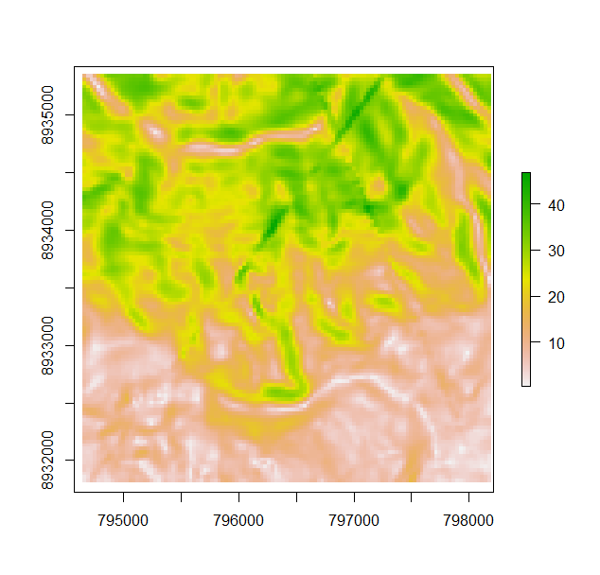
Let‘s run_qgis
Spatial object residing
in R
data("dem")
params$elevation <- dem
params$slope <- file.path(tempdir(), "slope.tif")
slope <- run_qgis(
"grass7:r.slope.aspect", params = params, qgis_env = qgis_env,
load_output = TRUE)
data("dem")
params$elevation <- dem
params$slope <- file.path(tempdir(), "slope.tif")
Loads automatically the QGIS ouptut
back into R

